Slide 1
K-means
CS 506

Slide 2



Do not edit
How to change the design
Is the following a possible output from K-means clustering?
The Slido app must be installed on every computer you’re presenting from

Slide 3
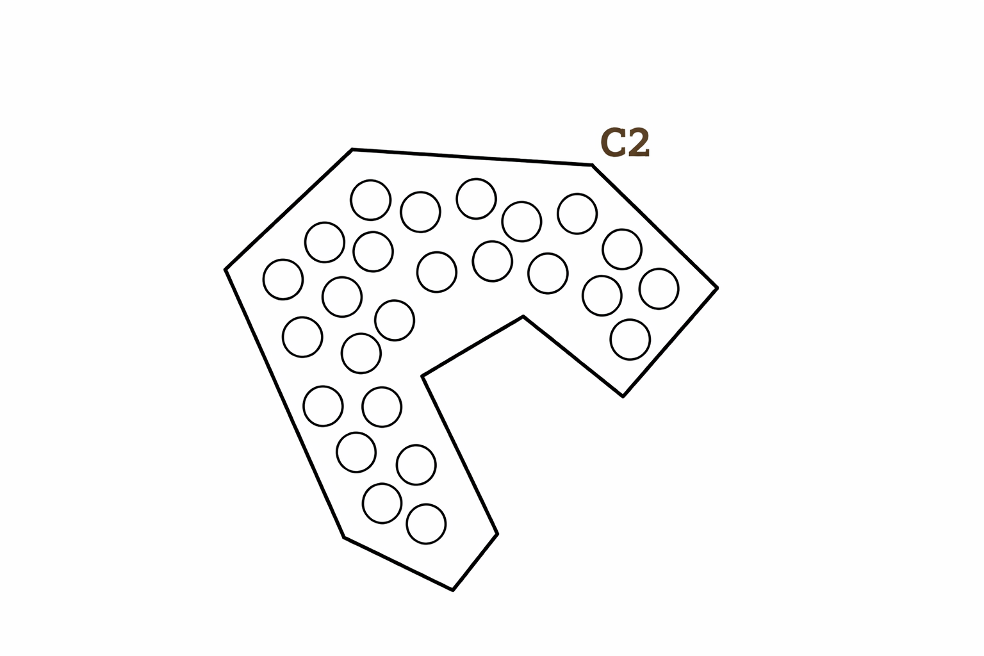
What is the center of C2?

Slide 5
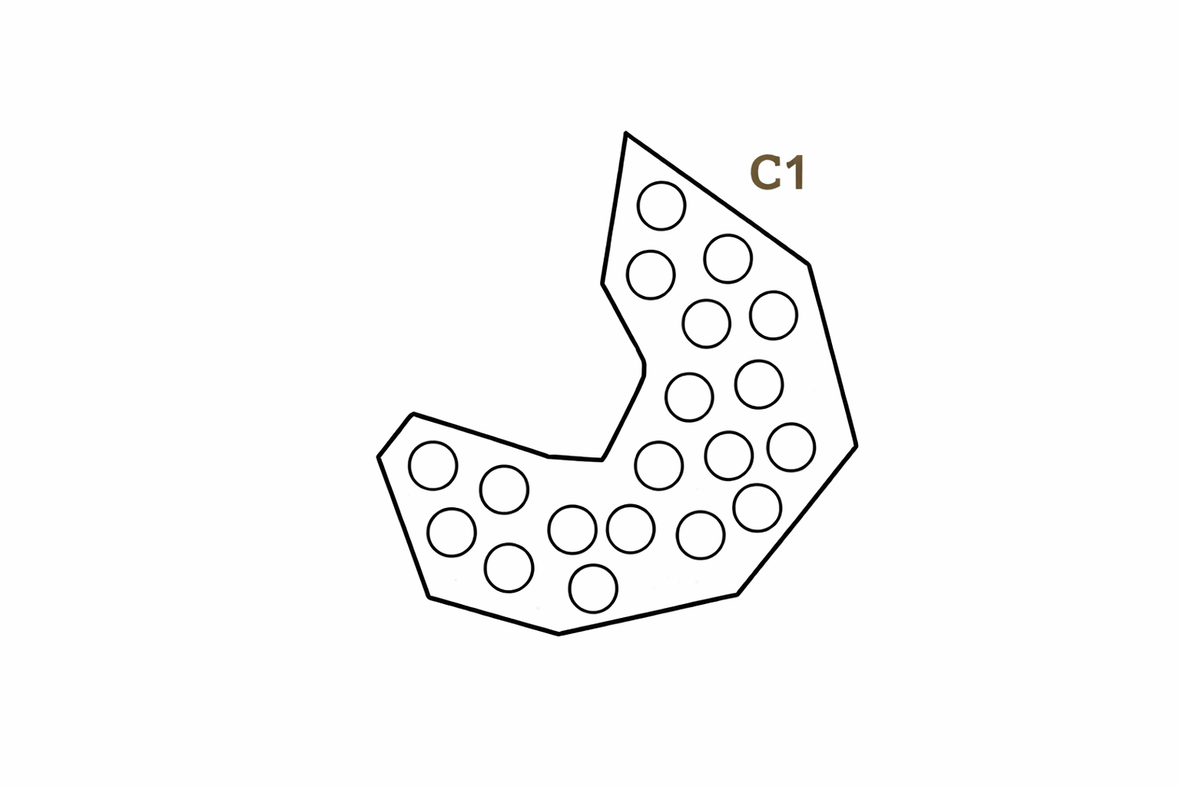
What is the center of C1?

Slide 7
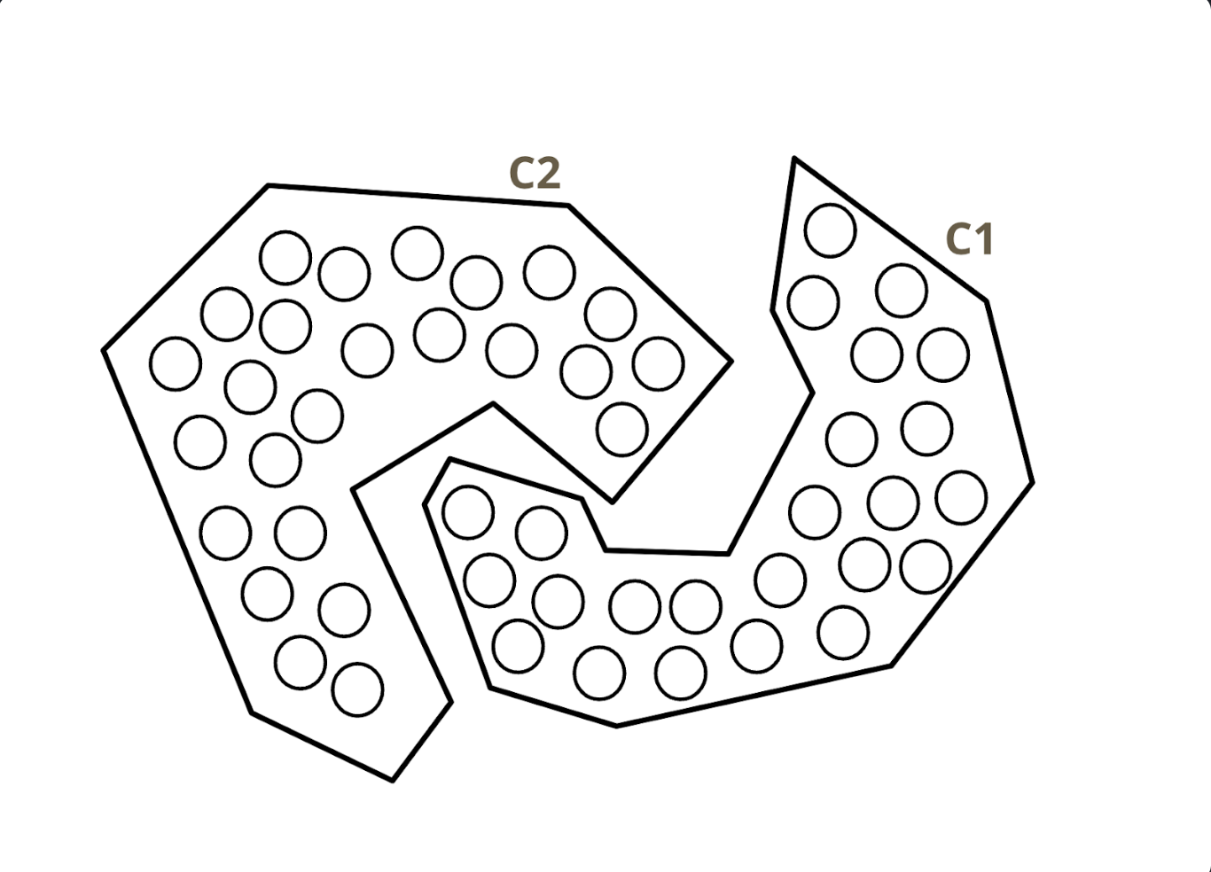
Hmmm… does this make sense?
i.e., if we were to iterate through Lloyd’s algorithm again, would we have this clustering?

Slide 8
Another perspective: can we minimize our cost function any further?
We want to compute the center of each cluster and see if any of the points in one cluster is closer to the center of the other cluster.

Slide 9
We want to compute the center of each cluster and see if any of the points in one cluster is closer to the center of the other cluster.
In this case, there are points in C1 closer to C2’s mean and vice-versa. Hence, K-means cannot converge to this clustering!

Slide 10
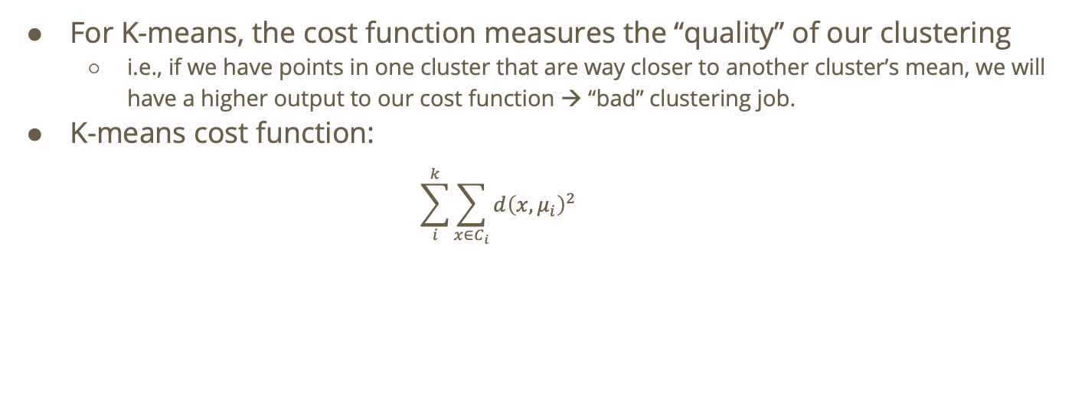
What exactly is the cost function?
For K-means, the cost function measures the “quality” of our clustering
  i.e., if we have points in one cluster that are way closer to another cluster’s mean, we will have a higher output to our cost function → “bad” clustering job.
K-means cost function:
  $$\sum_{i}^{k}{\sum_{x∈C_{i}}{d{\left(x,μ_{i}\right)}^{2}}}$$

Slide 11
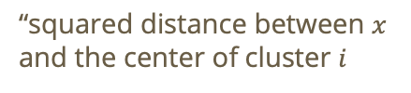
For K-means, the cost function measures the “quality” of our clustering
  i.e., if we have points in one cluster that are way closer to another cluster’s mean, we will have a higher output to our cost function → “bad” clustering job.
K-means cost function:
  $$\sum_{i}^{k}{\sum_{x∈C_{i}}{d{\left(x,μ_{i}\right)}^{2}}}$$
“squared distance between $x$ and the center of cluster $i$

Slide 12

For K-means, the cost function measures the “quality” of our clustering
  i.e., if we have points in one cluster that are way closer to another cluster’s mean, we will have a higher output to our cost function → “bad” clustering job.
K-means cost function:
  $$\sum_{i}^{k}{\sum_{x∈C_{i}}{d{\left(x,μ_{i}\right)}^{2}}}$$
“squared distance between $x$ and the center of cluster $i$
“sum for all points in cluster $i$

Slide 13
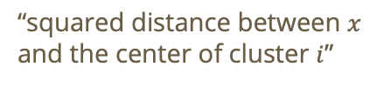

For K-means, the cost function measures the “quality” of our clustering
  i.e., if we have points in one cluster that are way closer to another cluster’s mean, we will have a higher output to our cost function → “bad” clustering job.
K-means cost function:
  $$\sum_{i}^{k}{\sum_{x∈C_{i}}{d{\left(x,μ_{i}\right)}^{2}}}$$
“sum over all k clusters”
“squared distance between $x$ and the center of cluster $i$”
“sum for all points in cluster $i$”

Slide 14
Do not edit
How to change the design
For a dataset X with N points, when k = 1, the total cost is:
(hint: variance formula is pictured)
The Slido app must be installed on every computer you’re presenting from

Slide 15
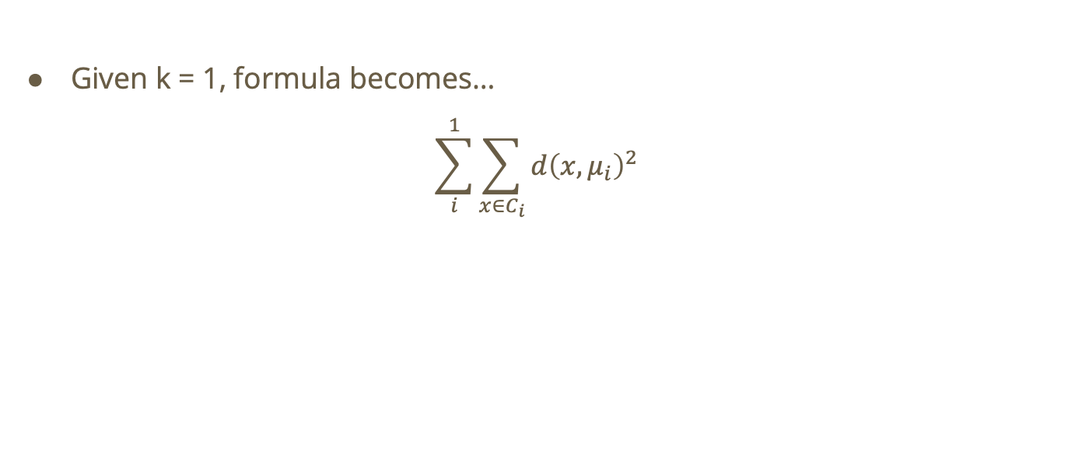
Solution
Given k = 1, formula becomes…
$$\sum_{i}^{1}{\sum_{x∈C_{i}}{d{\left(x,μ_{i}\right)}^{2}}}$$

Slide 16
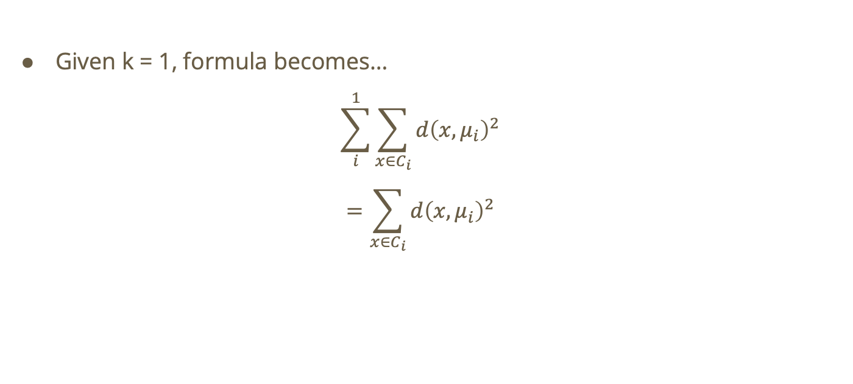
Given k = 1, formula becomes…
$$\sum_{i}^{1}{\sum_{x∈C_{i}}{d{\left(x,μ_{i}\right)}^{2}}}$$
$$=\sum_{x∈C_{i}}{d{\left(x,μ_{i}\right)}^{2}}$$

Slide 17
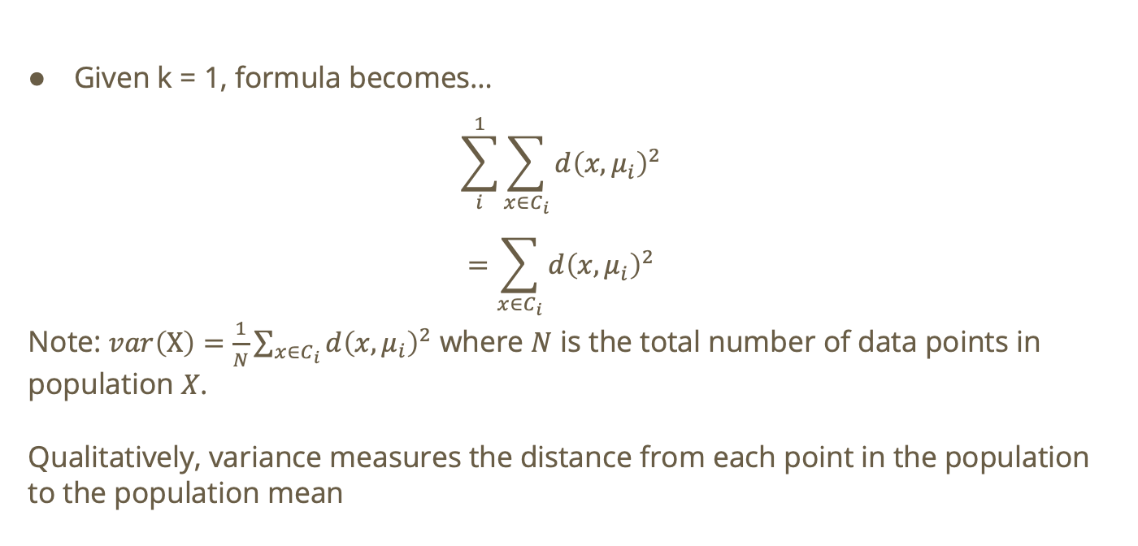
Given k = 1, formula becomes…
$$\sum_{i}^{1}{\sum_{x∈C_{i}}{d{\left(x,μ_{i}\right)}^{2}}}$$
$$=\sum_{x∈C_{i}}{d{\left(x,μ_{i}\right)}^{2}}$$
Note: $var\left(X\right)=\frac{1}{N}\sum_{x∈C_{i}}{d{\left(x,μ_{i}\right)}^{2}}$ where $N$ is the total number of data points in population $X$.
Qualitatively, variance measures the distance from each point in the population to the population mean

Slide 18
Do not edit
How to change the design
For a dataset X with N points, when k = N the total cost is:
The Slido app must be installed on every computer you’re presenting from

Slide 19

Solution
When $k = N:$
  Each cluster will only have 1 point
  Distance between each point in a cluster and the center is 0 (the center of the cluster will lie on the single point!)

Slide 20
Do not edit
How to change the design
Dataset: [-2, -1.5, .5, 1, 5.5, 6, 7.5]. With initial centroids 0 and 2, what are the final centroids?
The Slido app must be installed on every computer you’re presenting from

Slide 21
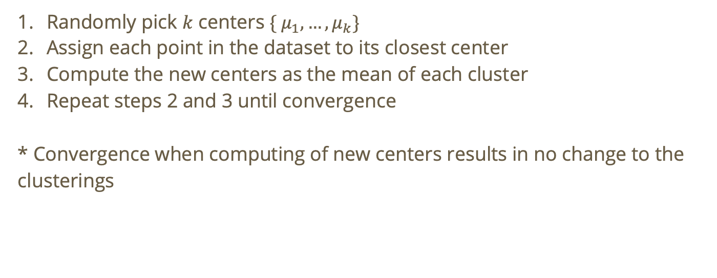
Recall: K-means Lloyd’s Algorithm
Randomly pick $k$ centers $\{ μ_{1},…,μ_{k}\}$
Assign each point in the dataset to its closest center
Compute the new centers as the mean of each cluster
Repeat steps 2 and 3 until convergence
* Convergence when computing of new centers results in no change to the clusterings

Slide 22

Solution
We’re given that $C_{1}=0 C_{2}=2$
  This is equivalent to $μ_{1}=0 μ_{2}=2$

Slide 23

Solution
We’re given that $C_{1}=0 C_{2}=2$
  This is equivalent to $μ_{1}=0 μ_{2}=2$
Based on the K-means algorithm, each point will be assigned to the closest cluster mean. Hence, we get the following clusters:
  $$C_{1}=\{−2,−1.5,0.5,1\} C_{2}=\{5.5,6,7.5\}$$

Slide 24
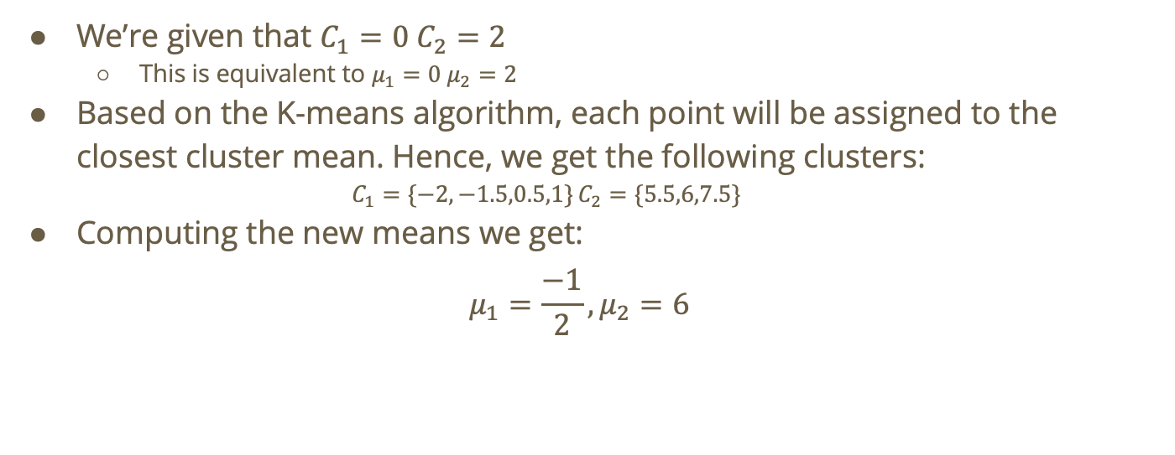
Solution
We’re given that $C_{1}=0 C_{2}=2$
  This is equivalent to $μ_{1}=0 μ_{2}=2$
Based on the K-means algorithm, each point will be assigned to the closest cluster mean. Hence, we get the following clusters:
  $$C_{1}=\{−2,−1.5,0.5,1\} C_{2}=\{5.5,6,7.5\}$$
Computing the new means we get:
$$μ_{1}=\frac{−1}{2},μ_{2}=6$$

Slide 25
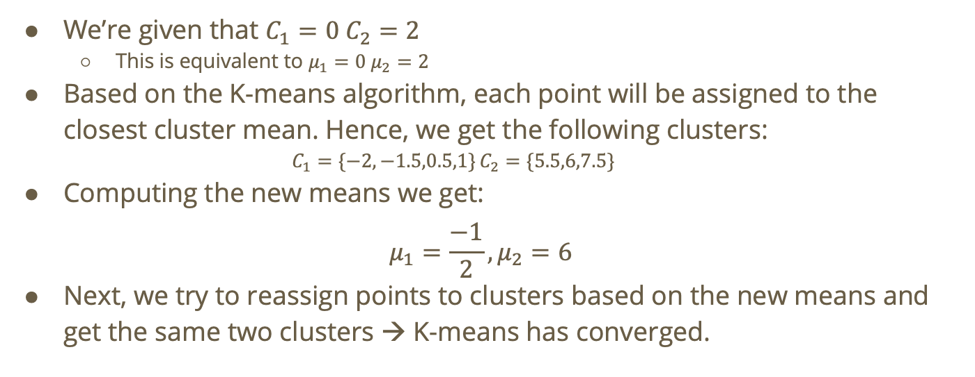
Solution
We’re given that $C_{1}=0 C_{2}=2$
  This is equivalent to $μ_{1}=0 μ_{2}=2$
Based on the K-means algorithm, each point will be assigned to the closest cluster mean. Hence, we get the following clusters:
  $$C_{1}=\{−2,−1.5,0.5,1\} C_{2}=\{5.5,6,7.5\}$$
Computing the new means we get:
$$μ_{1}=\frac{−1}{2},μ_{2}=6$$
Next, we try to reassign points to clusters based on the new means and get the same two clusters → K-means has converged.

Slide 26
Do not edit
How to change the design
Consider the 1-dimensional dataset: [3, 5, x]. With k=2, what is the smallest value of x (x > 5) beyond which x will always be alone in its own cluster no matter the initialization?
The Slido app must be installed on every computer you’re presenting from

Slide 27

Solution
Consider the following clustering: $C_{1}=\{3\} C_{2}=\{ 5,x\}$
We want to answer the question: for what $x$, will K-means not converge here?

Slide 28
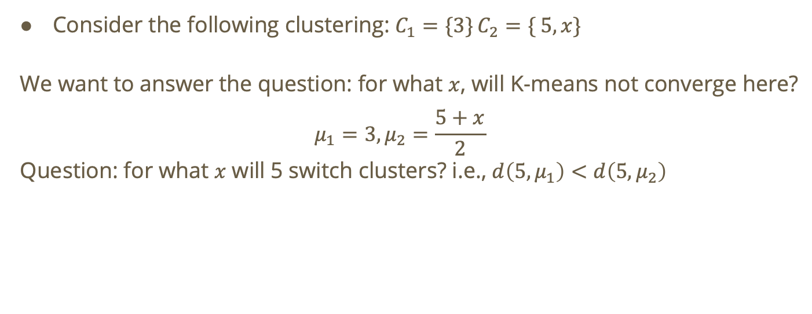
Solution
Consider the following clustering: $C_{1}=\{3\} C_{2}=\{ 5,x\}$
We want to answer the question: for what $x$, will K-means not converge here?
$$μ_{1}=3,μ_{2}=\frac{5+x}{2}$$
Question: for what $x$ will 5 switch clusters? i.e., $d\left(5,μ_{1}\right)<d\left(5,μ_{2}\right)$

Slide 29
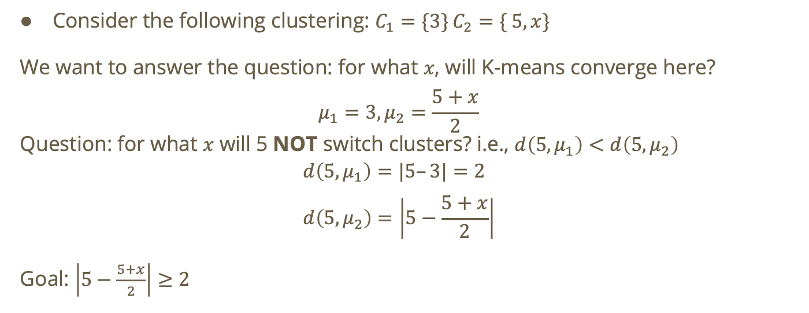
Solution
Consider the following clustering: $C_{1}=\{3\} C_{2}=\{ 5,x\}$
We want to answer the question: for what $x$, will K-means converge here?
$$μ_{1}=3,μ_{2}=\frac{5+x}{2}$$
Question: for what $x$ will 5 NOT switch clusters? i.e., $d\left(5,μ_{1}\right)<d\left(5,μ_{2}\right)$
$$d\left(5,μ_{1}\right)=|5–3|=2 \\ d\left(5,μ_{2}\right)=\left|5−\frac{5+x}{2}\right|$$
Goal: $\left|5−\frac{5+x}{2}\right|≥2$

Slide 30

Solution
Goal: $\left|5−\frac{5+x}{2}\right|≥2$
$$\left|5−\frac{5+x}{2}\right|≥2$$
$$=\left|\frac{10−\left(5+x\right)}{2}\right|≥2$$
$$=\left|\frac{5−x}{2}\right|≥2$$
$$=\frac{\left|5−x\right|}{2}≥2$$

Slide 31

Solution
Goal: $\left|5−\frac{5+x}{2}\right|≤2$
$$\frac{\left|5−x\right|}{2}≥2$$
Recall: $x>5$
$$=\frac{x−5}{2}≥2$$
$$= x ≥9$$
Interpretation: if $x ≥9$then we will end with the clustering $C_{1}=\{3, 5\} C_{2}=\{ x\}$

